Slide 1

Automation Recipes PAM with RPA
Nigel T. Crowther
Automation Tech Sales EMEA
IBM
IBM Robotic Process Automation
Try it now: https://www.ibm.com/account/reg/ca-en/signup?formid=urx-46597

Slide 2
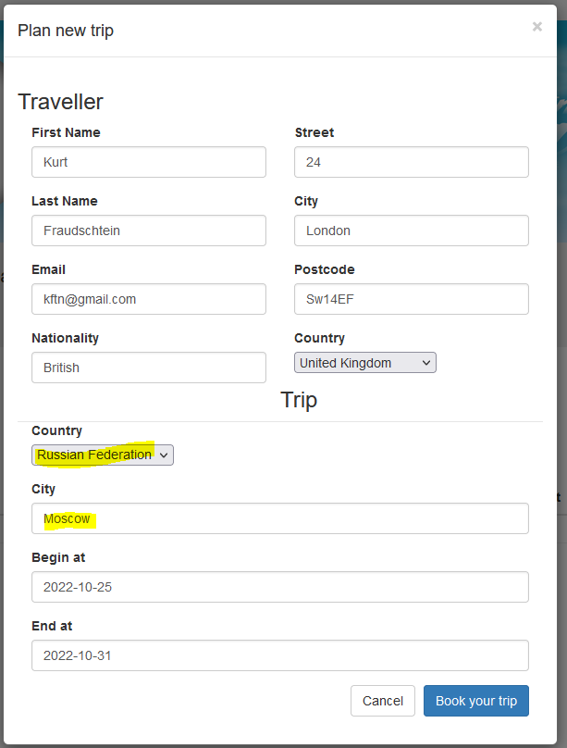
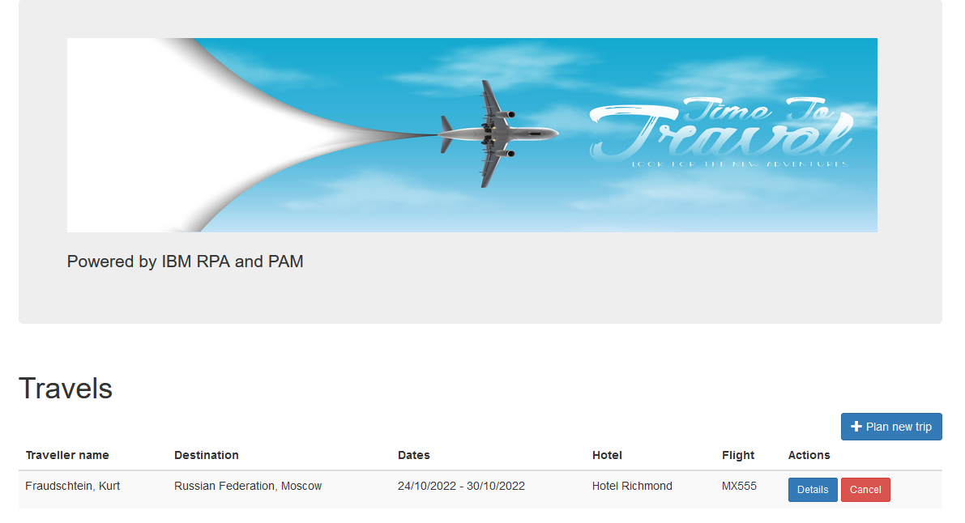
Problem
A travel agency is breaching guidelines by allowing bookings to dangerous countries
The agency will be fined unless fixed

Slide 3
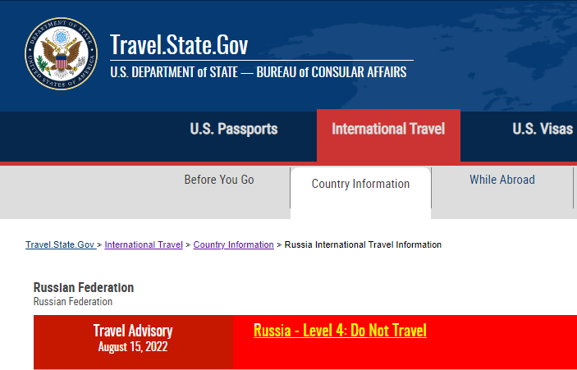
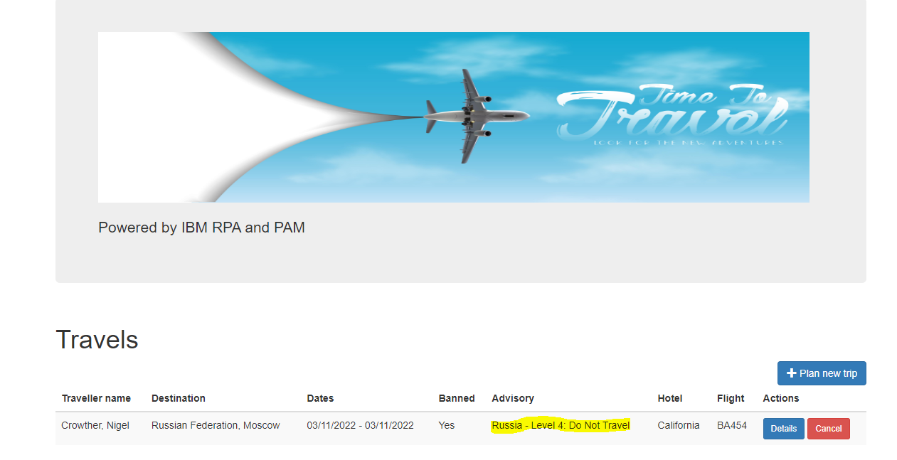
Solution
A bot is written to scrape data from the US Travel site.
The bot is exposed via a secure API
An BPMN task is created to call the bot and added to the existing flow
The flow blocks travel if the bot returns a banned destination
The problem is solved quickly and cost effectively using IBM RPA!

Slide 4
Step 1: Build the Bot
Using RPA recorder and the low code tools, the bot is built and tested.
The bot has a single input parameter – the destination country
The bot has two output parameters
The travel advisory giving the level of threat
A go/no go flag.

Slide 5
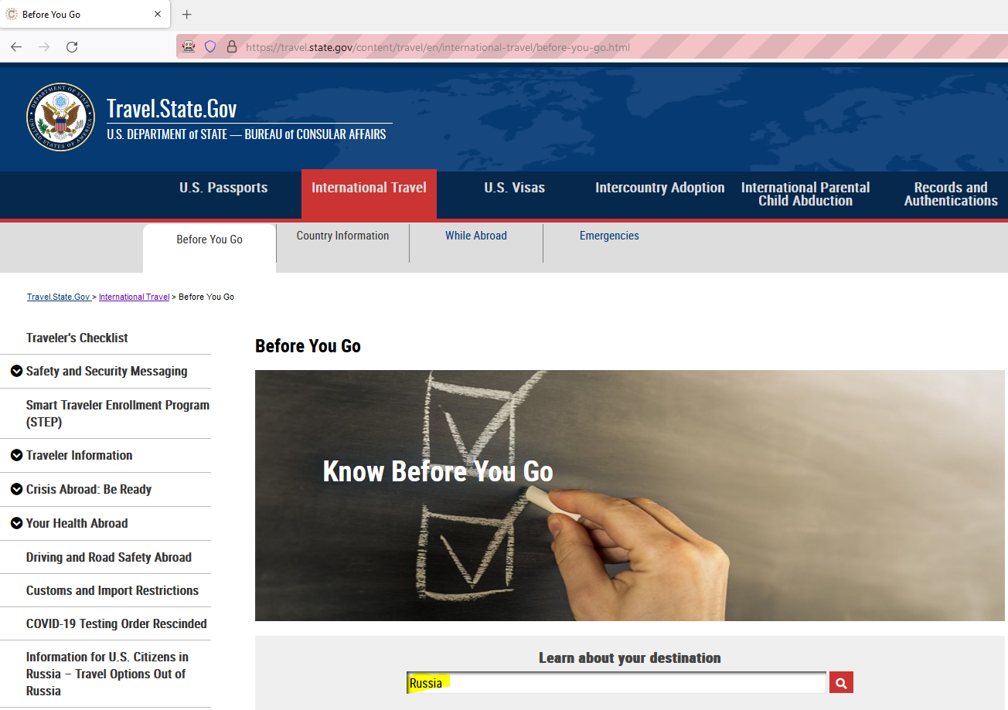
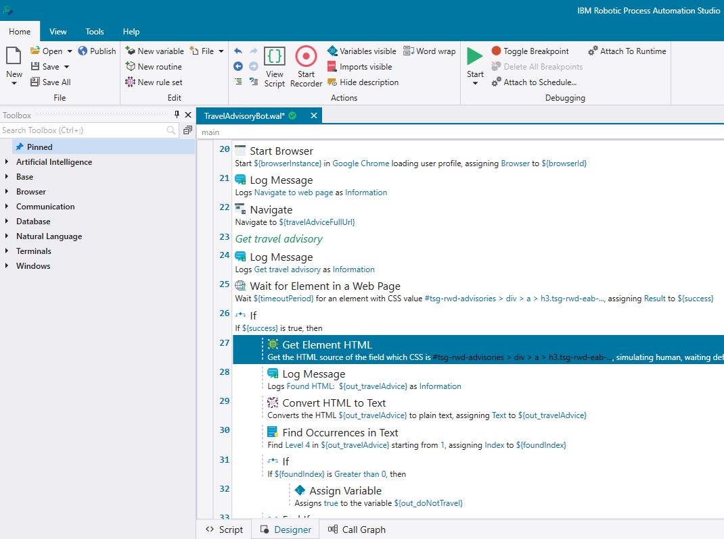
Build the Bot cont.

Slide 6
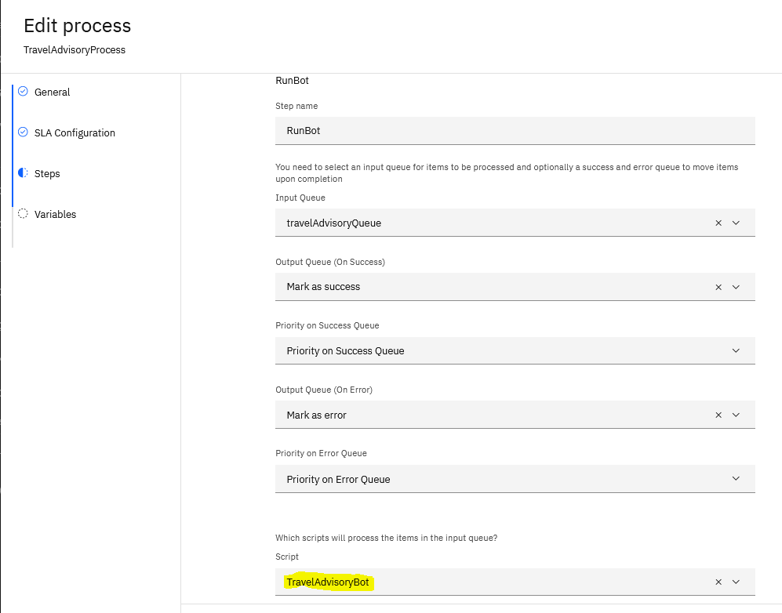
Step 2 – Expose the bot
Create a bot process with the RPA Control Center to enable the bot to be exposed via a REST API

Slide 7
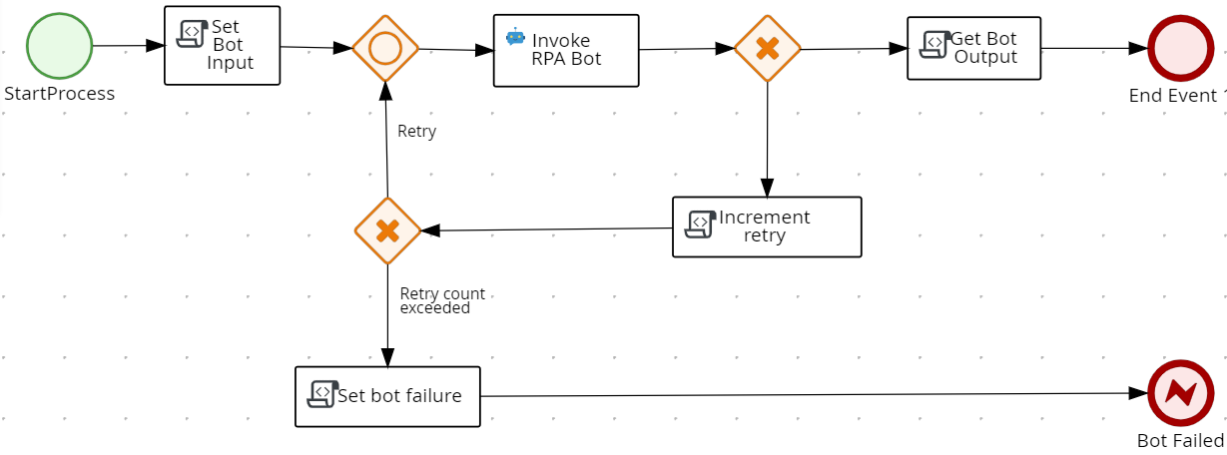
Step 3 – Call the bot from PAM Using a pre-built custom task, the RPA bot invocation is created and tested

Slide 8
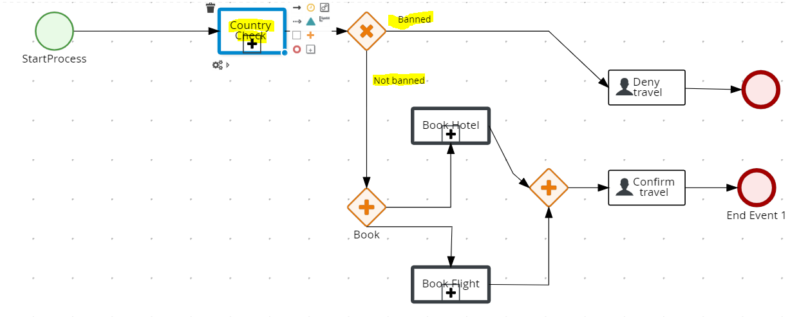
Step 4 – Update the existing flow The flow is plugged into the existing flow. We now have an updated flow that checks the destination and prevents booking if not on the government approved list

Slide 9
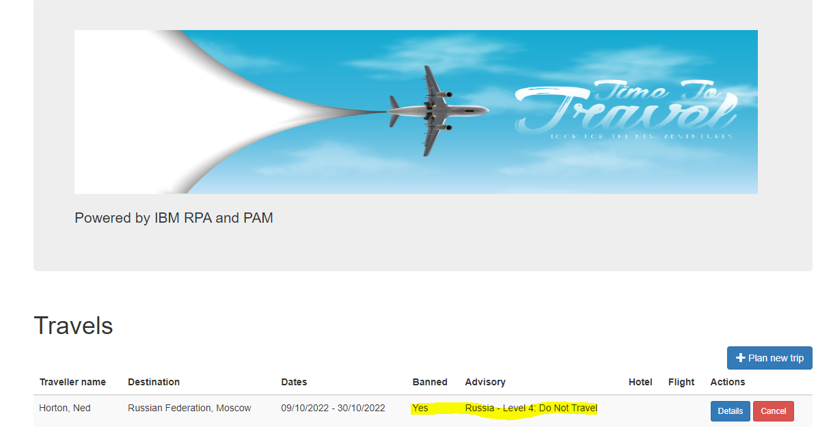
Result – Booking to Banned Country Prevented

